Slide 1
What is RO-Crate?
Resource aggregation (local & remote)
Rich context
Semantics
Citable

Slide 2
☁️
Addressable resources
📄
ID? Title? Description?
👩‍🔬👨🏿‍🔬Who created this data?
📄What parts does it have?
📅 When?
🗒️ What is it about?
♻️ How can it be reused?
🏗️ As part of which project?
💰 Who funded it?
⚒️ How was it made?
👩🏿‍🔬 https://orcid.org/0000-0001-2345-6789
📂
Local Data - Files
🔬 https://en.wikipedia.org/wiki/Scanning_electron_microscope
RO-Crate is method for describing a dataset as a digital object using a single linked-data metadata document

Slide 3
🔬 🔭 📹 💽 🖥️ ⚙️🎼🌡️🔮🎙️🔍🌏📡💉🏥💊🌪️
📂
The dataset may contain any kind of data resource about anything, in any format as a file or URL

Slide 4
{
"@id": "2021-04-08 07.58.17.jpg",
"@type": "File",
"contentSize": 3271409,
"dateModified": "2021-04-08T07:58:17+10:00",
"description": "",
"encodingFormat": [
{
"@id": "https://www.nationalarchives.gov.uk/PRONOM/x-fmt/391"
},
"image/jpeg"
],
"name": "Cute puppy"
},
|-- Folder1/
| |-- file1.this
| |-- file2.that
|-- Folder2/
| -- file1.this
| |-- file2.that
|-2021-04-08 07.58.17.jpg
📂
Each resource can have a machine readable description in JSON-LD format

Slide 5
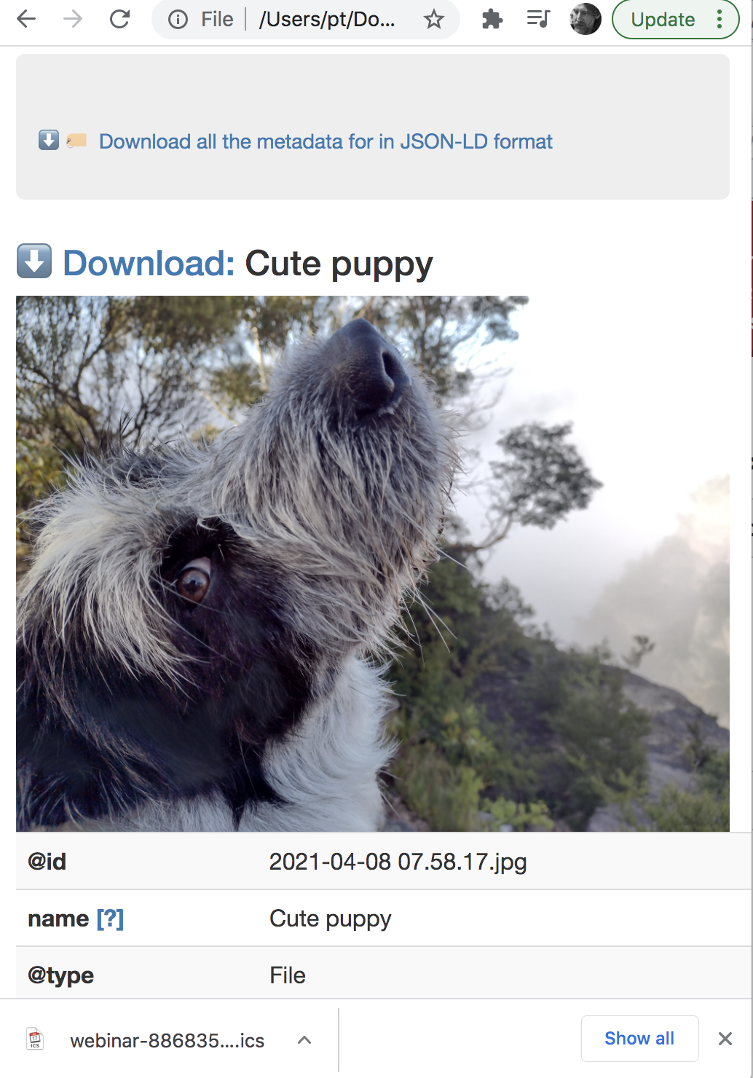
|-- Folder1/
| |-- file1.this
| |-- file2.that
|-- Folder2/
| -- file1.this
| |-- file2.that
|-2021-04-08 07.58.17.jpg
📂
A human-readable description and preview can be in an HTML file that lives alongside the metadata

Slide 6
♻️
🏭 CreateAction 🏭
Date: 2021-04-01
👩🏽‍🔬Agent
🔬instrument
🐥result
📂
⚙️Software / workflow
Name: My Workflow
URL: https://example.com/workflow/1235
📈Chart1
Provenance and workflow information can be included - to assist in data and research-process re-use

Slide 7
🎁🗜️📮🚚
RO-Crate Digital Objects may be packaged for distribution eg via Zip, Bagit and OCFL Objects

